Slide 1

Basic Details of the Team and Problem Statement
Central Ministry/ Policy Planning Cell, Ministry of Information & Broadcasting/Blockchain & Cybersecurity
PS Code: NS1224
Problem Statement Title:
An AI/ML based solution for flagging of false information related to the Union Government on online platforms, including social media platforms. Such a system may utilize the authentic information available through official sources such as documents, press releases, etc.
Team Name: CODERCUBE
Team Leader Name: AMIT YADAV
Institute name: NOIDA INSTITUTE OF ENGG. AND TECHNOLOGY (C-46232)
Theme Name: Blockchain & Cybersecurity

Slide 2
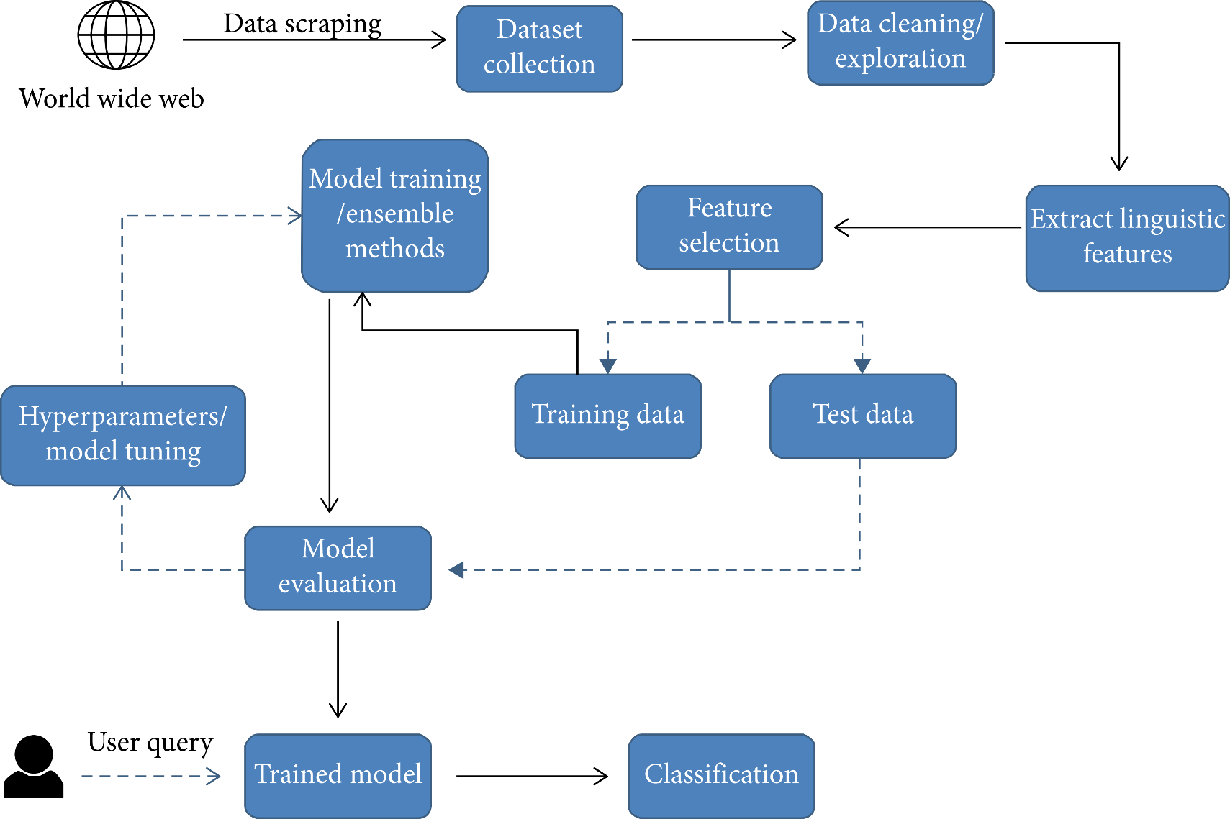
Idea/Approach Details
Design a system that will automatically detect whether a news is fake or not .
We will generate a keyword list with any information of government social media handles.
Using the keyword we will collect relevant news from various social media sites.
Pass the collected news to model to calculate whether the news is correct or not and assign a credibility score accordingly.
Technology stack :
Tensorflow
Pytorch
Selenium
Twitter API
Google API
Aws cloud server

Slide 3
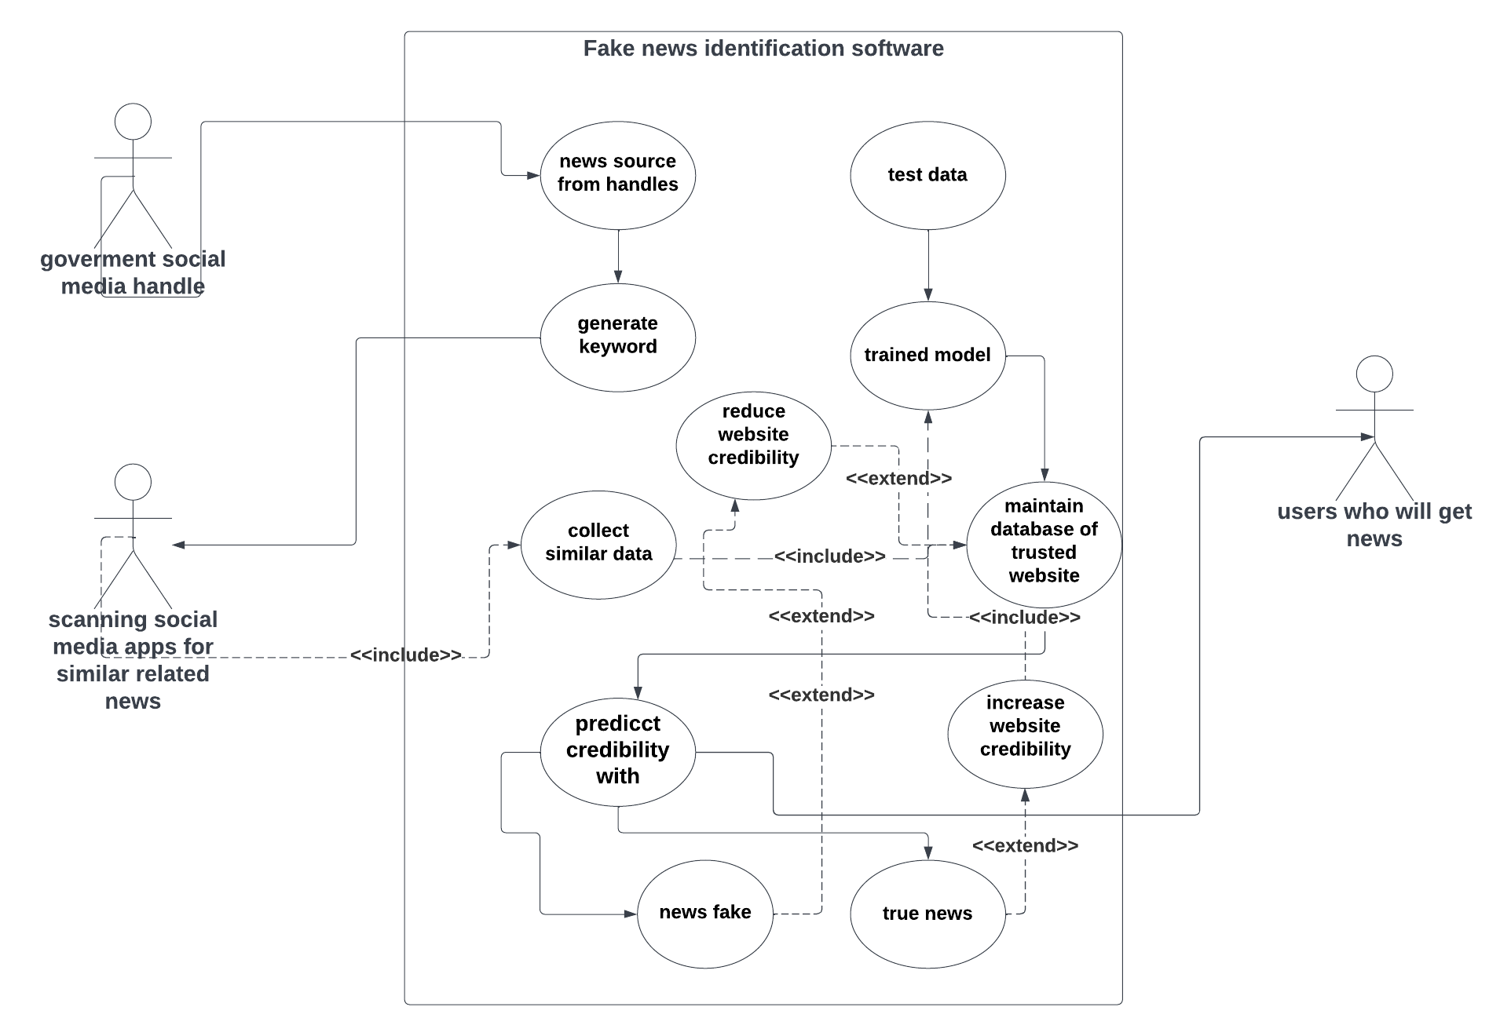
Idea/Approach Details
Use Case
Dependencies / Show stopper
Our AI model self trains itself and increase its accuracy.
He accuracy of the prediction completely depends upon the dataset.
We are using authentic dataset for training model
Our model works work with other social media other than twitter
We are mainly focused on government news portals
We will provide the data to public as open source api

Slide 4
Team Member Details
Team Leader Name: Amit Yadav
Branch : B-tech Stream : CSE (AI) Year : II
Team Member 1 Name: Prabhash Ranjan
Branch : B-tech Stream : CSE (DS) Year : II
Team Member 2 Name: Arijit Sharma
Branch : B-tech Stream : CSE (AI) Year : II
Team Member 3 Name: Komal Bharti
Branch : B-tech Stream : CSE (DS) Year : II
Team Member 4 Name: Rajan Kumar
Branch : B-tech Stream : CSE (DS) Year : II
Team Member 5 Name: Harsh Gupta
Branch : B-tech Stream : CSE (AI) Year : II
Team Mentor 1 Name: Dr. Vikas Sagar
Category : Academic Expertise : AI/ML Domain Experience (in years): 5
Team Mentor 2 Name: Mr. Yaduvir singh
Category : Academic Expertise AI/ML Domain Experience (in years): 5

